Slide 1
Doctor’s consultation Book an appointment in advance.
Developed by: Harish Babu Alle, Anurag Rao & Sravan kumar.
Guided by: Yash sheth.
Mobile Application Development,
Cegep de la gasipie

Slide 2
outline
Why ?
What is Doctor Consultation?
Solution
Features
Design Architectural
Technologies used
Reason for Technology used
GUI design
Division of Team
Possible future enhancements for the project.

Slide 3
Why?
Usually wait time at clinics for registration of patients takes long time.
Patient’s don’t have opportunity to choose their doctor.
Most Hospitals face issue with maintenance of patients record. There is much book keeping work in this regard.
Patient have to visit the hospital to confirm the availability of doctor.
Even to book an appointment over phone will take a long time.

Slide 4
What is Doctor Consultation?
Booking an appointment directly by visiting or over the phone is one of the most traditional method of scheduling an appointment.
However, it’s a major disadvantage for patients because they have to make an appointment during the working hours.
On the other hand, Doctor's Consultation through online is great for patients because it allows patients to schedule doctors appointment online at his or her own convenience.

Slide 5
Solution
One module in this application designed for the patient.
Patient can read specialty information of doctors
Patient can view history of old appointments
Patient can Signup/Login.
They can book an appointment at the flexible time and date.
They can cancel an appointment through their user page.

Slide 6
Solution
The second module is the admin module that is designed on the website.
The admin views all details of doctors and all appointments by the admin.
The admin can add doctor, view patient’s details and doctor’s details.
All the doctors of the specific Specialty are registered by the admin.
Doctors cannot register themselves.

Slide 7
solution
Last is doctors module
Doctors can have their own profile page.
Doctors can confirm or decline an appointment on their convenience.
Doctors can register by consulting admin.

Slide 8
FEATURES
It avoids wait time at clinics for registration of patients which takes a long time.
Here patient’s have opportunity to choose their doctor.
Hospitals can easily maintain patients record.
Patients can confirm the availability of doctor in advance with invoice.
Doctors can confirm or decline an appointment.
For identification purpose patient need to upload Government ID.

Slide 9
Technologies used
Project is developed in
Scripting language used : PHP, JAVA SCRIPT
Database used : MySQL (from xampp Server)
User Interface used for development : HMTL , CSS , BOOTSTRAP

Slide 10
Reason for technology
PHP is a general-purpose web development language (i.e. one of the most popular server-side scripting tools) based on HTML(Hyper Text Markup Language).
This platform is quite fast and considered as one of the best option for building dynamic web pages.
By using PHP one can develop website that are scalable, customizable, flexible,
It is easy to work with PHP .

Slide 11

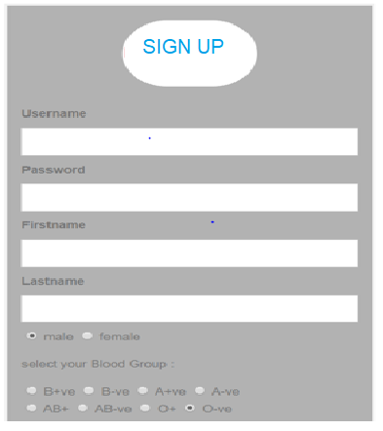
GUI DESIGN
HOME PAGE
PATIENT SIGN UP PAGE

Slide 12
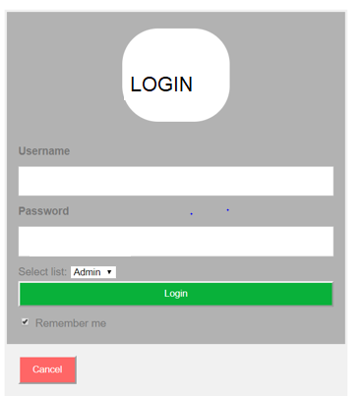
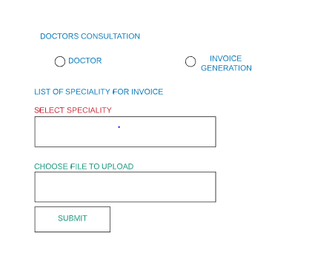
GUI DESIGN
LOGIN PAGE
DOCTORS PAGE

Slide 13
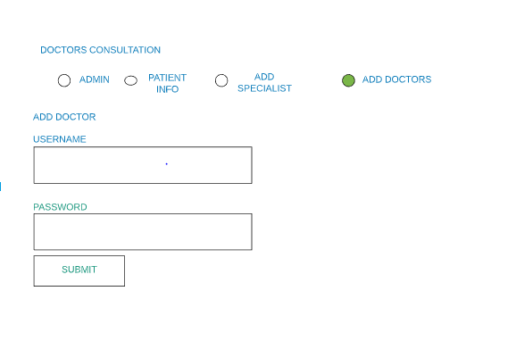
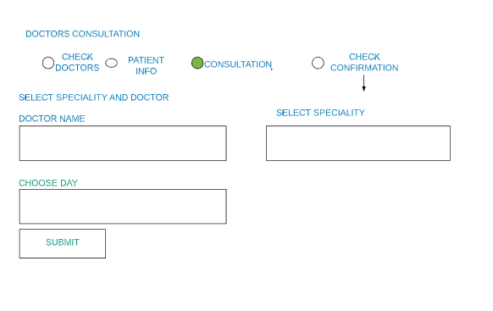
GUI DESIGN
ADMIN ADD DOCTORS PAGE
PATIENT CONSULTATION PAGE

Slide 14
Task Division of team
WORK SHARED AS
FRONTEND : ANURAG
BACKEND : HARISH BABU ALLE
DATABASE : Shravan kumar

Slide 15
Future enhancements
A payment or some amount may be charged to the users/patients while making an appointment to avoid the unethical users. As many users only register themselves just for fun and has no concern by making an appointment.
Some more future directions are the improvements in the patient’s module which includes setting reminders for the appointments and saving the appointment date to the calendar.

